Slide 1


Amazone Sales Data
: Analysis by Nidhi Desai

Slide 2

Hello everyone,
I am excited to share with you my project on Amazon sales data analysis! As part of my internship with Unified Mentor, I had the opportunity to work on this project and gain valuable insights into analyzing sales data.
In this project, I used PowerBI to analyze Amazon sales data and created visualizations to better understand trends and patterns.
I had a great time working on this project and learned a lot in the process. I hope it inspires you to dive into data analysis and explore the insights that can be gained from it.

Slide 3
Objective & Benefits
Perform ETL (Extract – Transform – Load)
Develop dashboard by using Power BI
Sales forecasting and trend analysis
Aggregate data points such as cost, revenue, profit, and sales at appropriate levels (daily, weekly, monthly) for meaningful analysis.

Slide 4

Bar Chart :

Slide 5
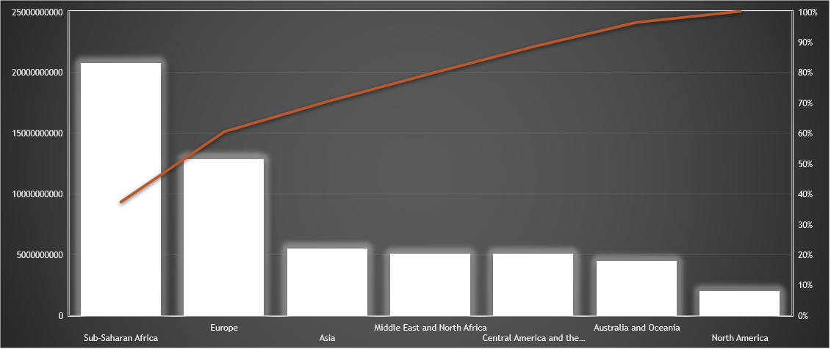
Pareto Chart :

Slide 6
Sum of Total Revenue by Order Priority

Slide 7
